Slide 1



Winning Space Race with Data Science: A Capstone Project
IBM Developer
SKILLS NETWORK
Mary Antonette Pinez May 07, 2024

Slide 2

Outline
Executive Summary
Introduction
Methodology
Results
Conclusion
Appendix

Slide 3

Executive Summary
Methodology
Data Collection
Data Wrangling
Exploratory Data Analysis (EDA) using Visualization and SQL
Visual Analysis using Folium and Plotly Dash
Predictive Analysis and Classification Models
Results
Exploratory Data Analysis
Visual Analysis
Predictive Analysis

Slide 4

Introduction
Background
The commercial space age is booming with companies like Virgin Galactic, Rocket Lab, Blue Origin, and SpaceX making space travel accessible. SpaceX, in particular, has achieved milestones such as sending spacecraft to the International Space Station, launching Starlink for satellite internet access, and carrying out manned missions.
Their cost-effective Falcon 9 rocket stands out, with a price of $62 million compared to competitors' $165 million. By reusing the first stage, SpaceX reduces expenses. Forest Katsch's diagrams show the significant size and importance of the first stage in Falcon 9 launches, even though there are occasional failures or intentional sacrifices based on mission requirements.
In this capstone, we will take the role of a data scientist working for a new rocket company. Space Y that would like to compete with SpaceX founded by Billionaire industrialist Allon Musk

Slide 5



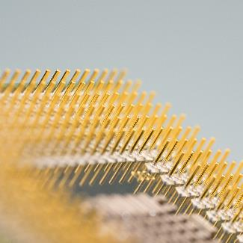

The Problem
Determine the price for each launch
Gather information about SpaceX
Create a dashoard for the team
Determine if SpaceX will reuse the 1st Stage
Train a Machine Learning Model

Slide 6


Methodology
Section 1

Slide 7

Methodology
Executive Summary
Data collection methodology
SpaceX Rest API
Wikipedia Web Scrapping
Perform data wrangling
Data Analysis
EDA
Determining Training Labels
Perform exploratory data analysis (EDA) using visualization and SQL
Perform interactive visual analytics using Folium and Plotly Dash
Perform predictive analysis using classification models
Building, tuning and evaluation of classification models to ensure the best results

Slide 8

SpaceX REST API Columns
FlightNumber, Date, BoosterVersion, PayloadMass, Orbit, LaunchSite, Outcome, Flights, GridFins, Reused, Legs, LandingPad, Block, ReusedCount, Serial, Longitude, Latitude
Wikipedia Web Scraping Columns
Flight No., Launch site, Payload, PayloadMass, Orbit, Customer, Launch outcome, Version Booster, Booster landing, Date, Time
Data Collection
Data was collected via API queries from SpaceX's REST API and web scraping from a table in the company's Wikipedia article.

Slide 9
SpaceX API
Data Collection Flow Chart
Requesting rocket launch data from SpaceX API
Decoding the response content using .json() and turning it into a dataframe using .json_normalize()
Requesting needed information about the launches from SpaceX API by applying custom functions
Constructing data we have obtained into a dictionary
Exporting the data to CSV
Replacing missing values of Payload Mass column with calculated .mean() for this column
Filtering the dataframe to only include Falcon 9 launches
Creating a dataframe from the dictionary

Slide 10
Wikipedia Web Scrapping
Data Collection Flow Chart
Requesting Falcon 9 launch data from Wikipedia
Creating a BeautifulSoup object from the HTML response
Extracting all column names from the HTML table header
Collecting the data by parsing HTML tables
Exporting the data to CSV
Creating a dataframe from the dictionary
Constructing data we have obtained into a dictionary

Slide 11

Data Wrangling
Perform exploratory Data Analysis and determine Training Labels
Calculate the number of launches on each site
Calculate the number and occurrence of each orbit
Calculate the number and occurrence of mission outcome per orbit type
Create a landing outcome label from Outcome column
Exporting the data to CSV

Slide 12
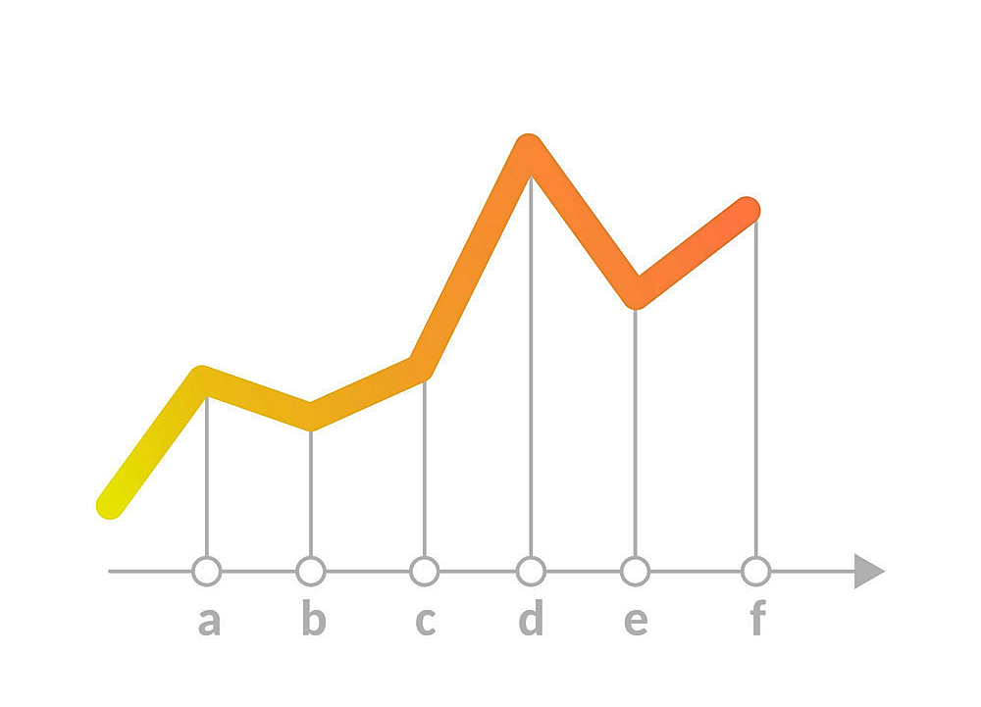
EDA using Visualization
Charts Plotted:
Flight Number vs. Payload Mass
Flight Number vs. Launch Site
Payload Mass vs. Launch Site
Orbit Type vs. Success Rate
Flight Number vs. Orbit Type
Payload Mass vs Orbit Type
Success Rate Yearly Trend

Slide 13
EDA using SQL
SQL Queries:
Displaying the names of the unique launch sites in the space mission
Displaying 5 records where launch sites begin with the string ‘CCA‘
Displaying the total payload mass carried by boosters launched by NASA (CRS)
Displaying average payload mass carried by booster version F9 v1.1
Listing the date when the first successful landing outcome in ground pad was achieved
Listing the names of the boosters which have success in drone ship and have payload mass greater than 4000 but less than 6000
Listing the total number of successful and failure mission outcomes
Listing the names of the booster versions which have carried the maximum payload mass
Listing the failed landing outcomes in drone ship, their booster versions and launch site names for the months in year 2015
• Ranking the count of landing outcomes (such as Failure (drone ship) or Success (ground pad)) between the date 2010-06-04 and 2017-03-20 in descending order

Slide 14


Visual Analysis with Folium and Plotly Dash
Folium
Plotly Dash
Markers of all Launch Sites:
Added Marker with Circle, Popup Label and Text Label of NASA Johnson Space Center using its latitude and longitude coordinates as a start location. –
Added Markers with Circle, Popup Label and Text Label of all Launch Sites using their latitude and longitude coordinates to show their geographical locations and proximity to Equator and coasts.
Coloured Markers of the launch outcomes for each Launch Site:
Added coloured Markers of success (Green) and failed (Red) launches using Marker Cluster to identify which launch sites have relatively high success rates.
Distances between a Launch Site to its proximities:
Added coloured Lines to show distances between the Launch Site KSC LC-39A (as an example) and its proximities like Railway, Highway, Coastline and Closest City.
Launch Sites Dropdown List:
Added a dropdown list to enable Launch Site selection.
Pie Chart showing Success Launches (All Sites/Certain Site)
Added a pie chart to show the total successful launches count for all sites and the Success vs. Failed counts for the site, if a specific Launch Site was selected.
Slider of Payload Mass Range:
Added a slider to select Payload range.
Scatter Chart of Payload Mass vs. Success Rate for the different Booster Versions:
Added a scatter chart to show the correlation between Payload and Launch Success.

Slide 15
Predictive Analysis using Classification Models
Process:
Creating a NumPy array from the column “Class” in data
Standardizing the data with StandardScaler, then fitting and transforming it
Splitting the data into training and testing sets with train_test_split function
Creating a GridSearchCV object with cv = 10 to find the best parameters
Finding the method performs best by examining the Jaccard_score and F1_score metrics
Examining the confusion matrix for all models
Calculating the accuracy on the test data using the method .score() for all models
Applying GridSearchCV on LogReg, SVM, Decision Tree, and KNN models

Slide 16

Results

Slide 17
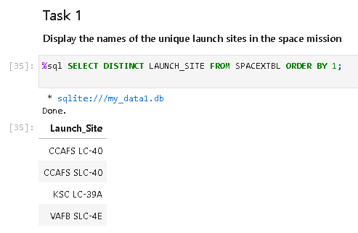
EDA using SQL

Slide 18
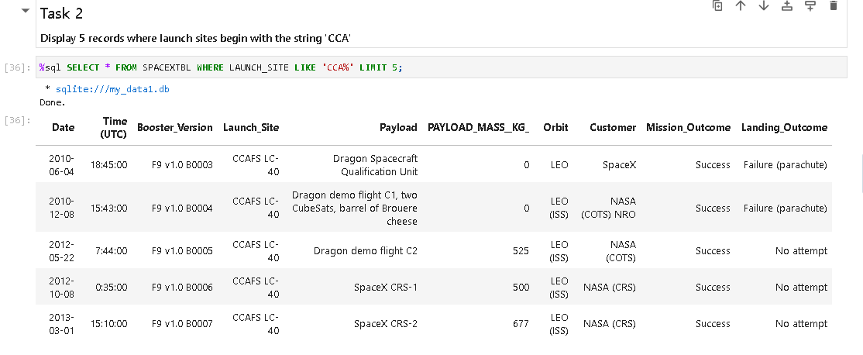
EDA using SQL

Slide 19
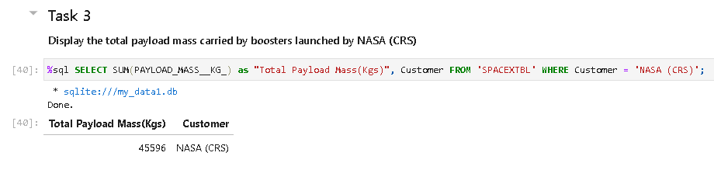
EDA using SQL

Slide 20
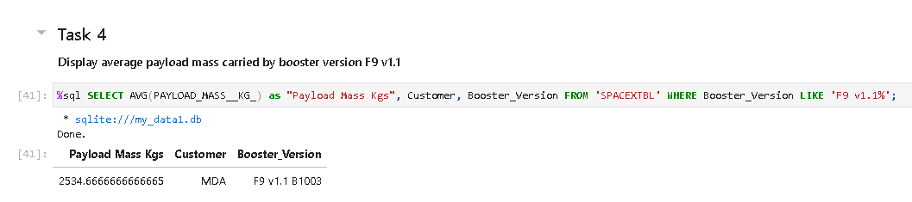
EDA using SQL

Slide 21
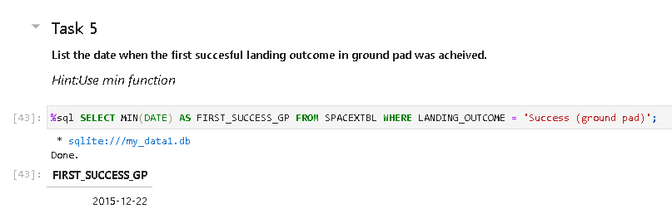
EDA using SQL

Slide 22
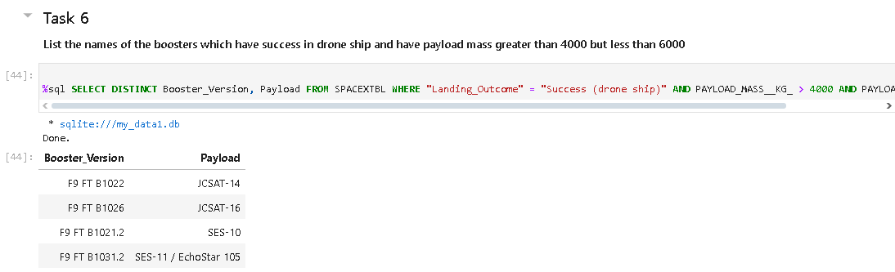
EDA using SQL

Slide 23
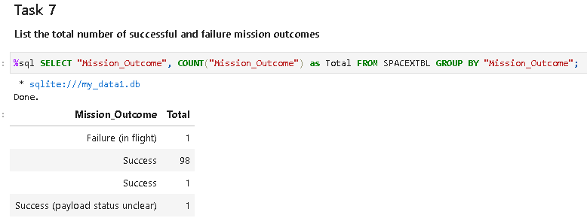
EDA using SQL

Slide 24
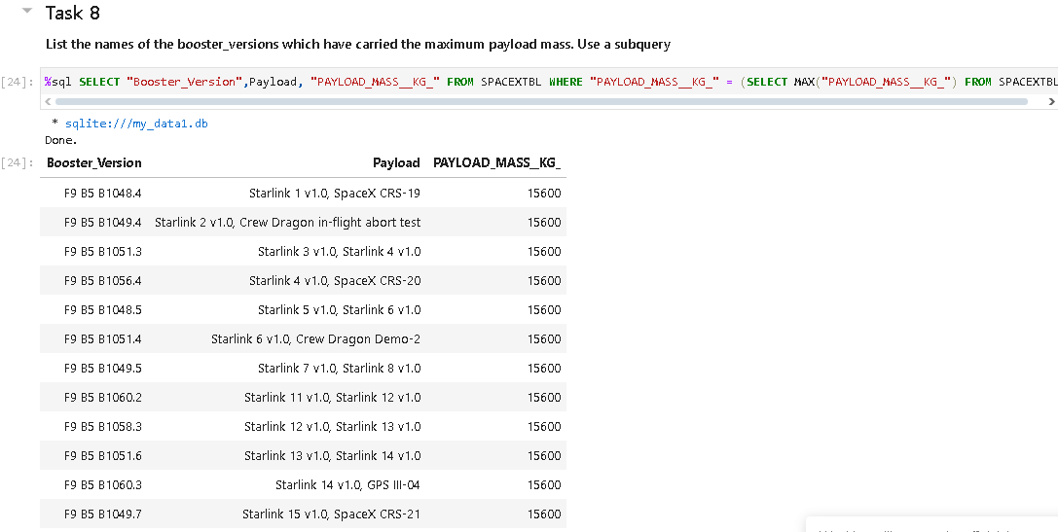
EDA using SQL

Slide 25
EDA using SQL

Slide 26
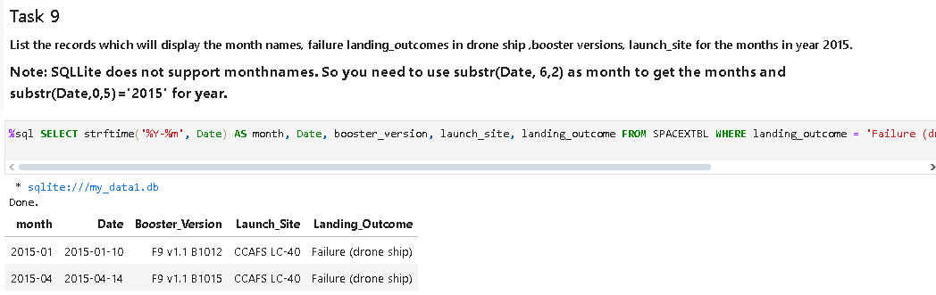
EDA using SQL

Slide 27
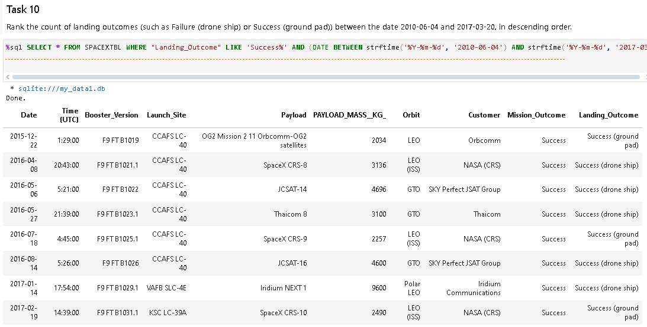
EDA using SQL

Slide 28
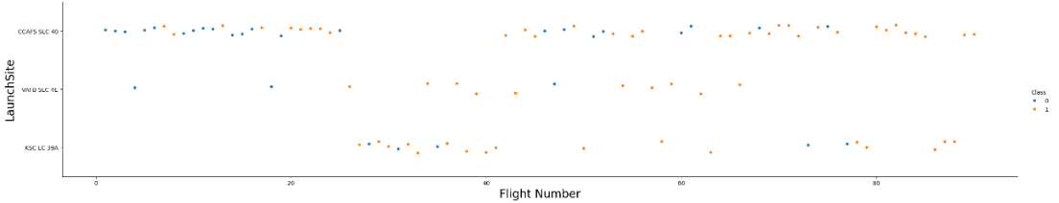
EDA using Visualization
Flight Number vs. Launch Site
We see that different launch sites have different success rates. CCAFS LC-40, has a success rate of 60 %, while KSC LC-39A and VAFB SLC 4E has a success rate of 77%.

Slide 29
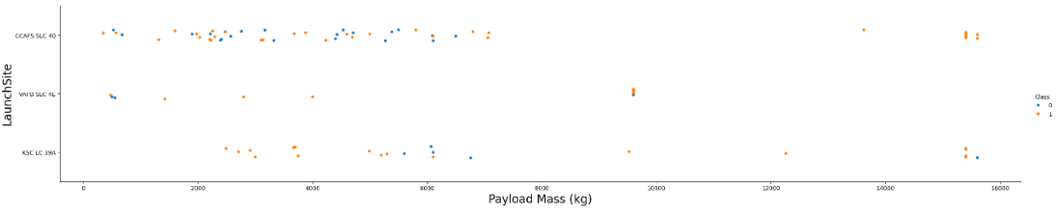
EDA using Visualization
Payload Mass vs. Launch Site
Now if you observe Payload Vs. Launch Site scatter point chart you will find for the VAFB-SLC launchsite there are no rockets launched for heavypayload mass(greater than 10000).

Slide 30
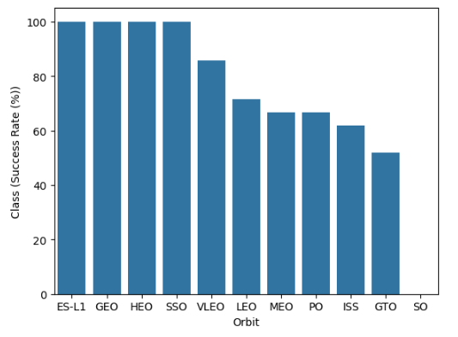
EDA using Visualization
Success rate vs. Orbit type
Highest success rating:
ES-L1
GEO
HEO
SSO
50-70% Success rating:
VLEO
LEO
MEO
PO
ISS
GTO
0% Success rating:
SO

Slide 31
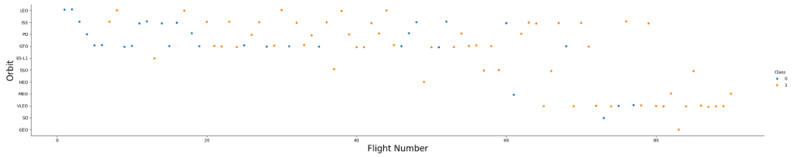
EDA using Visualization
Flight Number vs. Orbit type
LEO orbit the Success appears related to the number of flights; on the other hand, there seems to be no relationship between flight number when in GTO orbit.

Slide 32
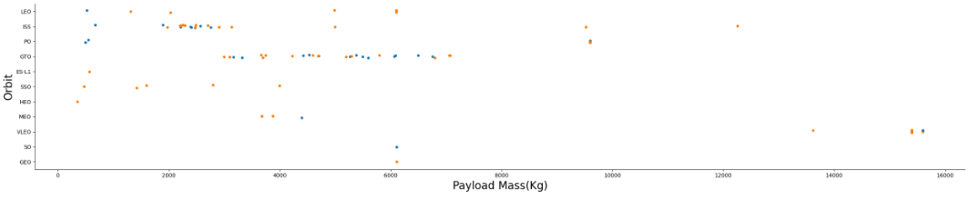
EDA using Visualization
Payload Mass vs. Orbit type
With heavy payloads the successful landing or positive landing rate are more for Polar, LEO and ISS.
However for GTO we cannot distinguish this well as both positive landing rate and negative landing(unsuccessful mission) are both there here.

Slide 33
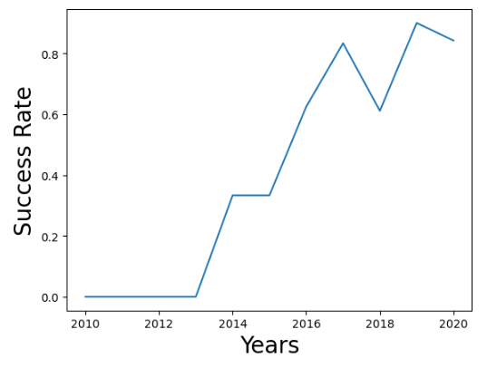
EDA using Visualization
You can observe that the success rate since 2013 kept increasing till 2020

Slide 34
EDA using Visualization
You can observe that the success rate since 2013 kept increasing till 2020

Slide 35
Launch Sites Proximities Analysis
Section 3

Slide 36
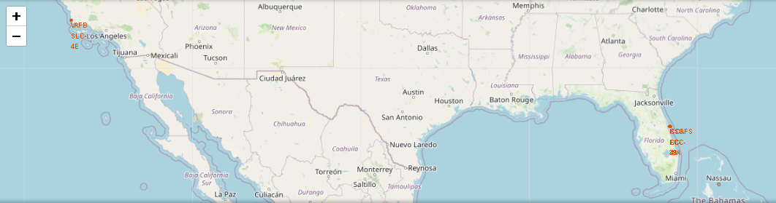
EDA using Visualization
Payload Mass vs. Orbit type
With heavy payloads the successful landing or positive landing rate are more for Polar, LEO and ISS.
However for GTO we cannot distinguish this well as both positive landing rate and negative landing(unsuccessful mission) are both there here.

Slide 37
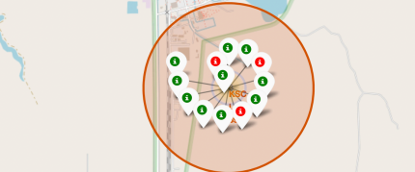
EDA using Visualization
Green Marker = Successful Launch
Red Marker = Failed Launch

Slide 38
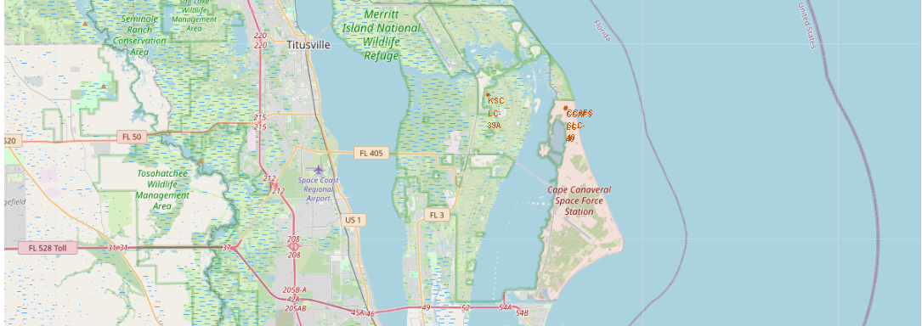
EDA using Visualization
With heavy payloads the successful landing or positive landing rate are more for Polar, LEO and ISS.
However for GTO we cannot distinguish this well as both positive landing rate and negative landing(unsuccessful mission) are both there here.

Slide 39
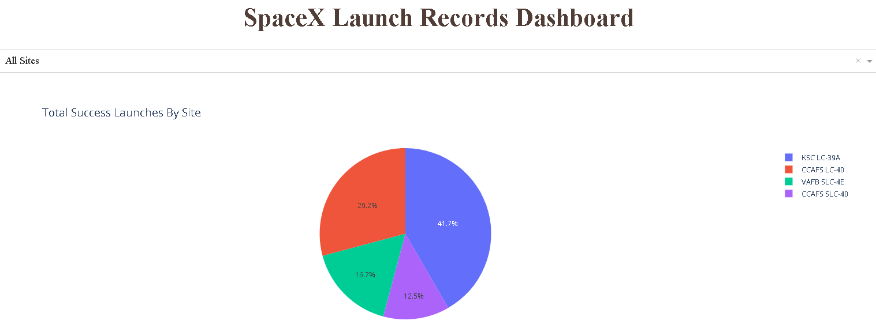
Launch Success Count for All Sites
With heavy payloads the successful landing or positive landing rate are more for Polar, LEO and ISS.
However for GTO we cannot distinguish this well as both positive landing rate and negative landing(unsuccessful mission) are both there here.

Slide 40
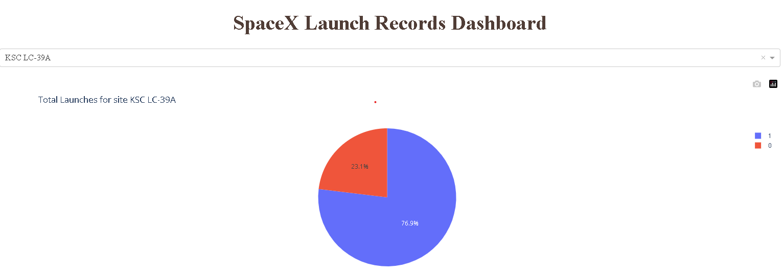
Piechart for KSC LC 39A (Highest Launch Rate)
With heavy payloads the successful landing or positive landing rate are more for Polar, LEO and ISS.
However for GTO we cannot distinguish this well as both positive landing rate and negative landing(unsuccessful mission) are both there here.

Slide 41
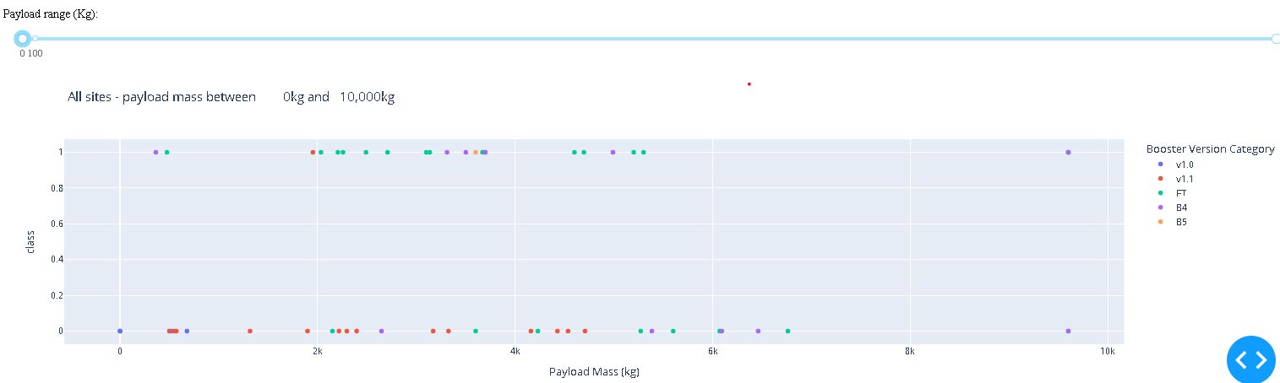
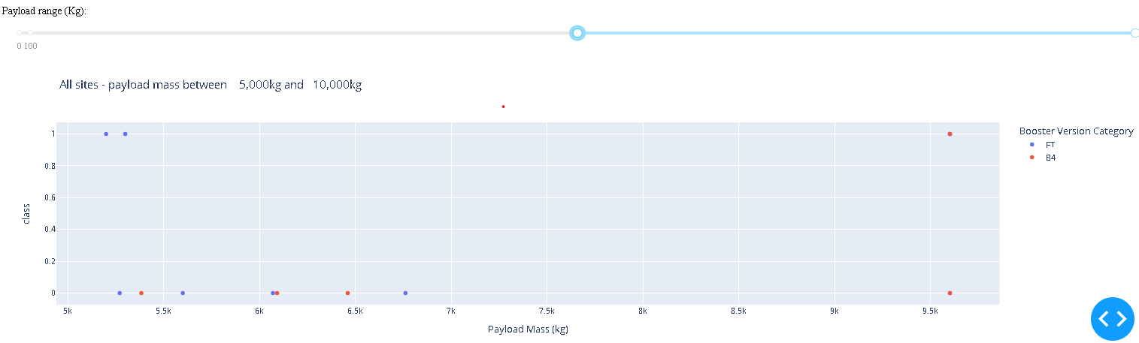
Payload Mass vs. Launch Outcome
It can be visibly seen that payloads between 2,500 kg and 5,000 kg maintain the highest succession rate

Slide 42
Launch Sites Proximities Analysis
Section 3

Slide 43
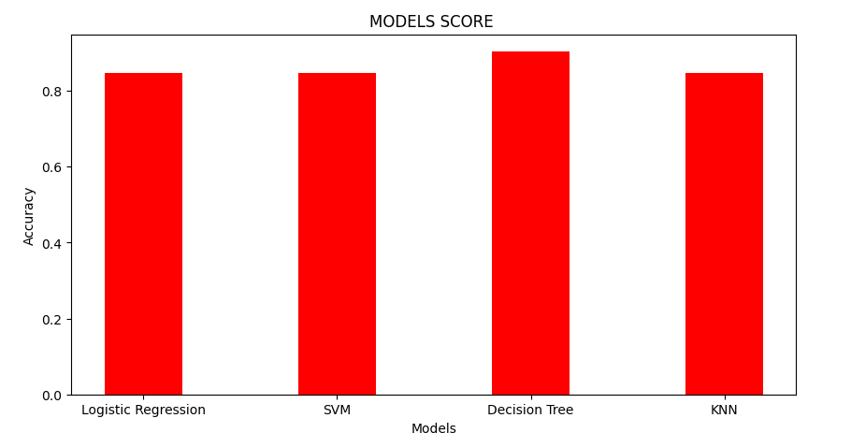
Classification Accuracy
The Test Set results do not indicate which strategy is the most effective.
Small test sample size (18 samples) may contribute to similar test set scores. Therefore, we examined all approaches using the entire dataset.
The Decision Tree Model was shown to be the most effective based on overall dataset scores. This model has the greatest scores and accuracy.

Slide 44
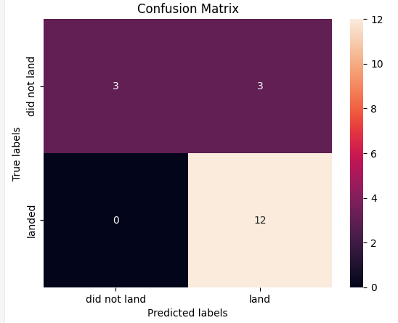
Confusion Matrix
The confusion shown in the picture is the best performing Confusion Matrix.
All four categorization models contained the same confusion matrix which allowed for equal differentiation across classes.
The main issue is that false positives are present across all models.

Slide 45
Conclusion
Based on the scores of the Test Set, we can not confirm which method performs best.
Same Test Set scores may be due to the small test sample size (18 samples). Therefore, we tested all methods based on the whole Dataset.
The scores of the whole Dataset confirm that the best model is the Decision Tree Model. This model has not only higher scores, but also the highest accuracy.

Slide 46

Digital Product
Emphasize your main benefit
Other benefits include
Nunc viverra imperdiet enim. Fusce est. Vivamus a tellus
Nunc viverra imperdiet enim. Fusce est. Vivamus a tellus

Slide 47


Thank You
Mary Antonette Pinez

